Slide 1
DeeNice Client updates
Friday, November 13, 2020
Wendy Liao, Alex Barstow, Matthew Brady

Slide 2
Schedule
Completed Items
HTTP/DNS
iSCSI
SMB
WAC
SpiceWorks
Pending Items
Risk Management
Value Added

Slide 3
Completed items
Task | Status
Configure a Jump Server and ensure that it is loaded with appropriate management tools | Completed
Deploy 2 vSphere hosts | Completed
Ensure that the vSphere hosts can connect over the management network | Completed
HTTP | Completed
DNS | Completed
Active Directory (not LDAP) | Completed
iSCSI Target | Completed
iSCSi initiator(this needs to be a separate platform from vSphere) | Completed
iSCSI - CHAP (Challenge Handshake Authentication Protocol) - Value add | Completed
Windows Admin Center (WAC) (Requires Microsoft Server 2019) | Completed
Connect WAC to your Domain using domain admin credentials | Completed
Spiceworks or similar inventory management system | Completed
File Server (SMB, NFS, or other) – SMB | Completed

Slide 4
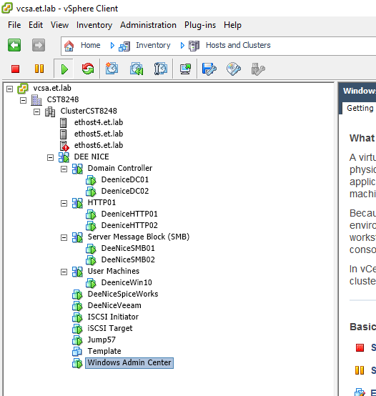
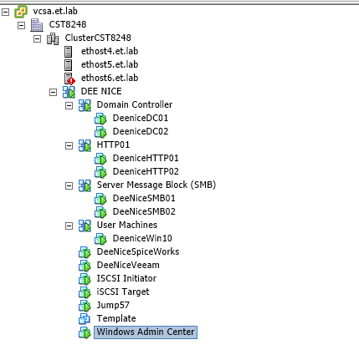
vSphere Client Machines

Slide 5
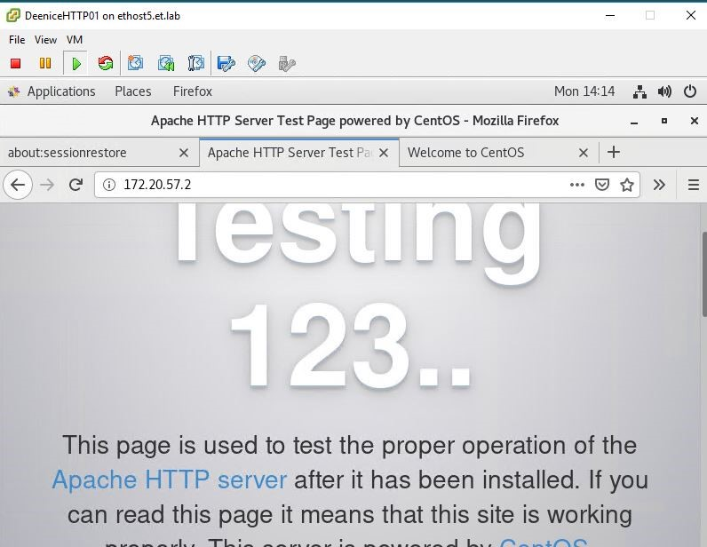
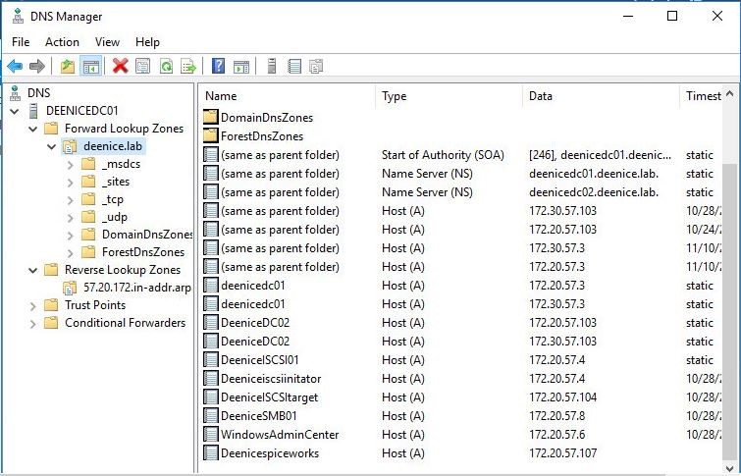
HTTP/DNS

Slide 6
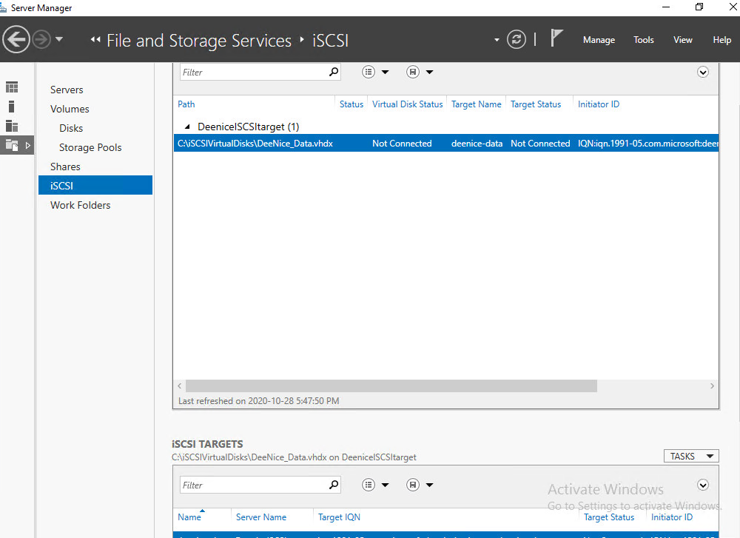
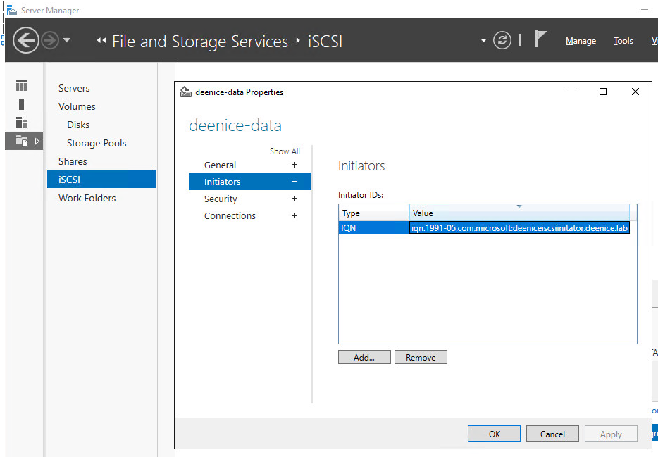
ISCSI Target
iSCSI Target – Server Manager information
iSCSI Target – Connected to Initiator

Slide 7
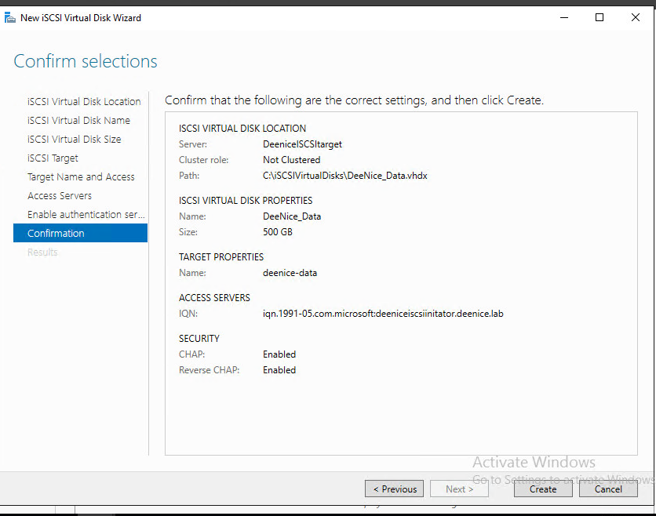
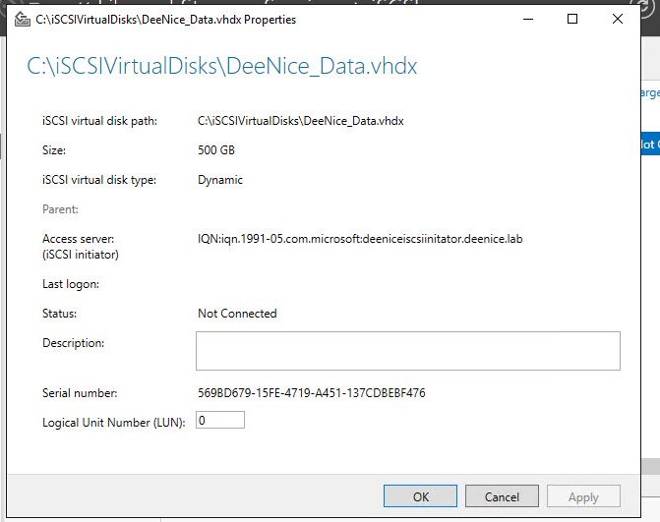
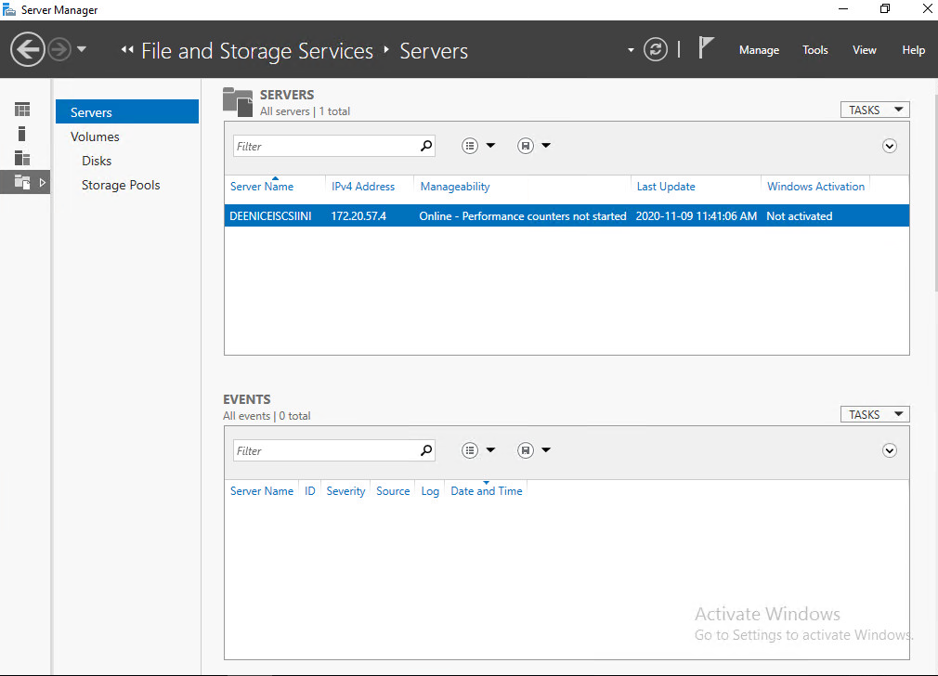
ISCSI Initiator
iSCSI Initiator
iSCSI Target and Initiator connection-
Disk information
iSCSI with CHAP enabled
iSCSI Initiator – Server Manager

Slide 8
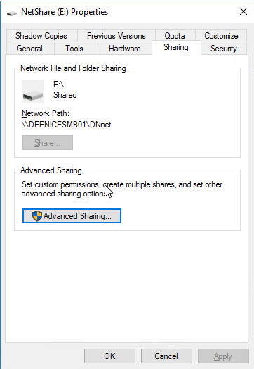
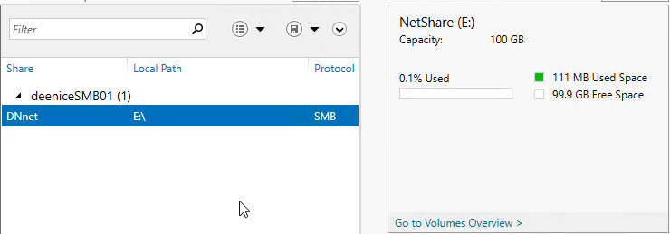
Service Message Block Protocol (SMB)
Currently using a 40GD drive on dniceSMB01
Share path is: \\deeniceSMB01\DNnet

Slide 9
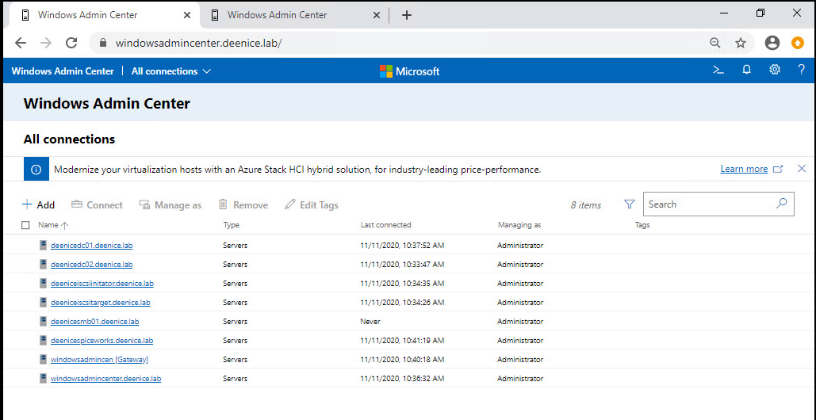
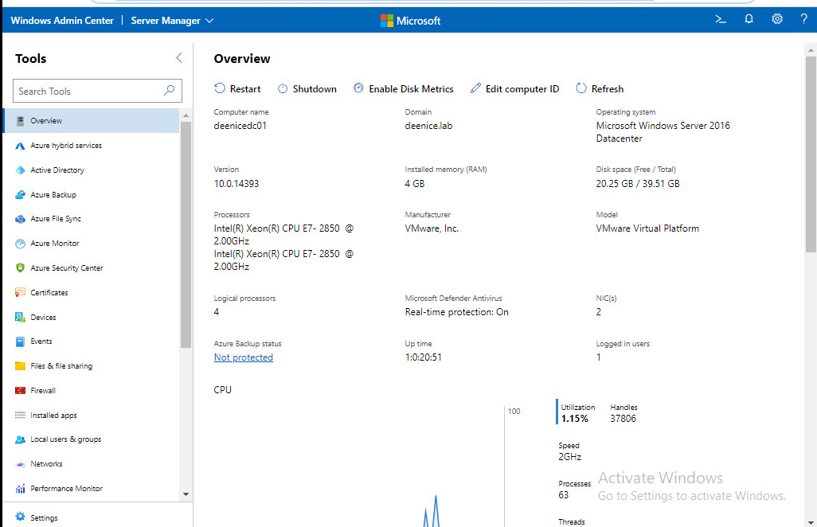
Windows Admin Center (WAC)

Slide 10
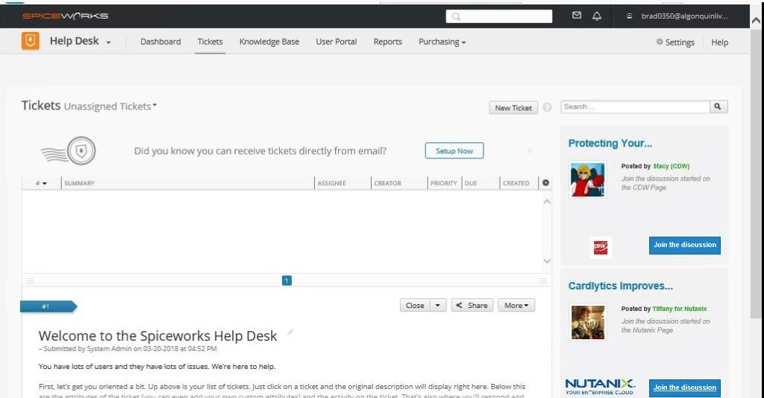
SpiceWorks

Slide 11
Pending items – Local
Task | Status | Expected completion date
Veeam Community Edition(Enterprise Backup) | Pending | November 15th, 2020
Spiceworks or similar inventory management system | Pending | November 17th, 2020
Collect inventory information using WAC and Spiceworks | Pending | November 20th, 2020
vSphere nodes should have separate/dedicated iSCSI LUNS. | Pending | November 15th, 2020
Deploy 2 Client Machines. 1 Linux and 1 Windows | Pending
Create at least 1 Administrator account and 1 client account | Pending | November 21st
Ensure network connectivity to all devices | Pending | November 30th, 2020
Ensure that devices have service connectivity | Pending | November 30th. 2020
Use Power CLI to determine the status of machines within your vAppPublic Cloud: | Pending

Slide 12
Pending Items - Public Cloud
Task | Expected Date | Responsible
Establish Governance in public cloud | Nov 21st | Matthew
Policies | Nov 21st | Matthew
RBAC | Nov 21st | Matthew
Deploy a VM in Azure running PostGre SQL | Nov 21st | Matthew
Create a web server into the Azure cloud. | Nov 21st | Alex
Connect your web server to your database VM | Nov 21st | Wendy
Azure Dashboard for all service | Nov 21st | Alex
Secure the communication between the Web front end and the backend by leveraging Network Security Group | Nov 21st | Wendy
Use PowerShell to determine the status of VM’s within your subscription | Nov 21st | Alex

Slide 13
Existing and potential barriers
Risk | Mitigation Strategy
Network Connectivity & Slowdown | Schedule more time for items and reschedule work
Troubleshooting & Misconfigured components | Ensure devices are configured properly and documented. Reach out over Teams if we run into an issue
Conflicting Priorities (Work, School, Life) | Schedule tasks as needed with an understanding that their may be overflow
Waiting for class | With classes and demonstrations being pushed back we are beginning to research and begin public cloud.
Testing | We have dedicated a week before our demonstration to testing and documentation.

Slide 14
Value added items
ISCSI CHAP – handshake protocol
MSCT (Microsoft Server Compliance toolkit) Incomplete
Azure Chat bot

Slide 15
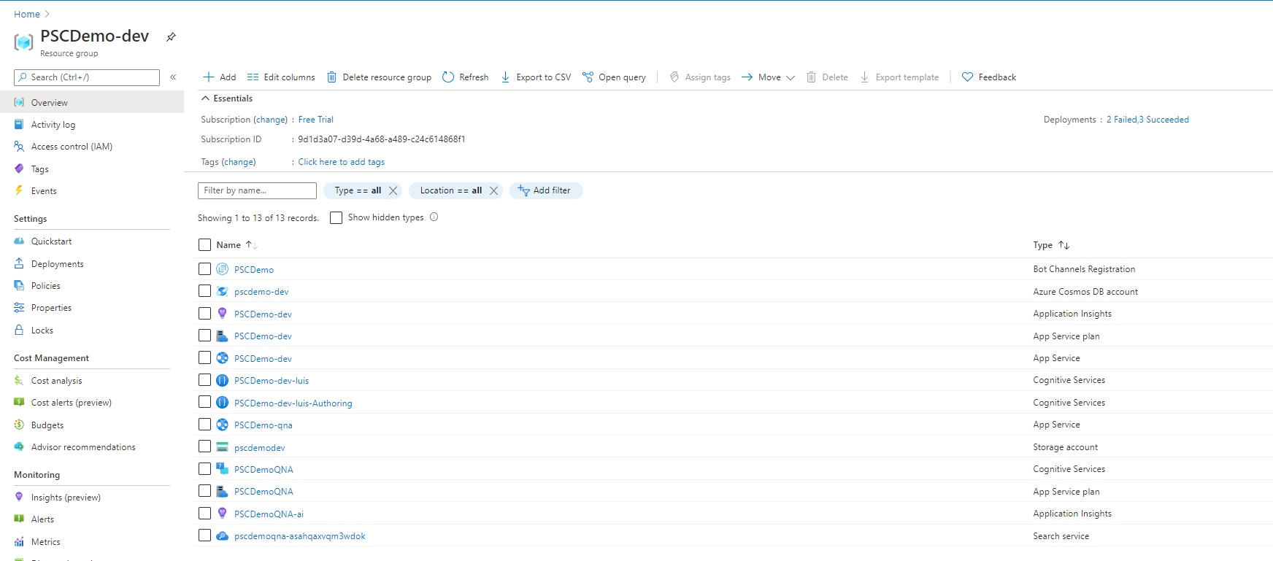
Azure Chat Bot
Created using MS Bot Framework
Uses Azure QnA Maker and LUIS
Language Comprehension chat bot
Can answer predefined questions and recognize 2 intents.
Intents: Book a meeting, Find Contact.

Slide 16
Questions?

